Slide 1
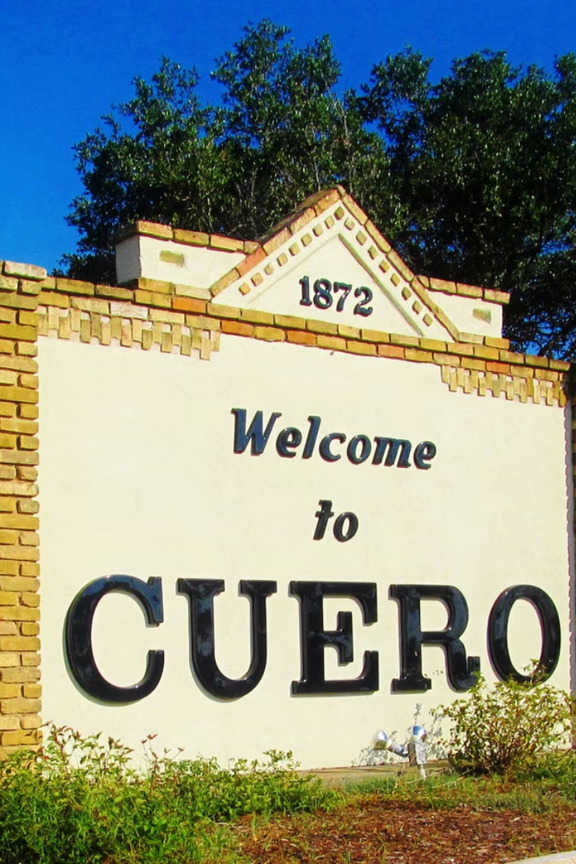
State of Cuero: Economic Development Overview
Presented by:
Maggie Cromeens, Executive Director, Cuero Development Corporation

Slide 2

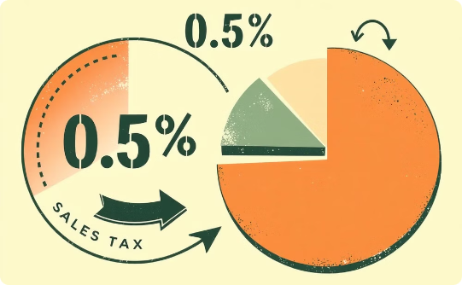
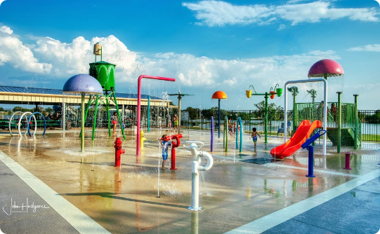
Cuero Economic Development Corporation
Mission and Purpose
Cuero’s Sales Tax for Economic Development
Impact of EDC Funding
The Cuero EDC fosters economic growth, enhances quality of life, and promotes sustainable development in Cuero, Texas.
Funding supports public infrastructure, business retention, workforce development, and quality-of-life enhancements.
A 0.5% Type B Sales Tax funds the Cuero EDC, supporting projects improving economic infrastructure and local businesses.

Slide 3



Understanding Cuero's Sales Tax Revenue
Statewide Sales Tax Projections
Impact on Cuero
Cuero's Strategic Initiatives
Sales tax revenues fluctuate due to economic conditions and consumer spending. Texas projects 8.7% growth (to $88.1 billion) in 2024-2025. This provides context for potential local revenue trends.
This competitive rate funds essential services and development projects. Strategic initiatives and economic indicator monitoring position Cuero for future growth.
Cuero is well-positioned to navigate future challenges and capitalize on growth opportunities by adhering to strategic initiatives and monitoring economic indicators.

Slide 4
Key Achievements in 2023-2024
Grants & Financial Assistance
Broadband & Infrastructure
Marketing & Promotion
$1,320,132.05 in Business Retention & Expansion funding
Partnerships with AT&T and RISE Fiber
Enlisted ReSimplifi to market commercial properties
$30,000 in rental assistance distributed
Addressed connectivity challenges for local businesses
Implemented EDO IQ for better operations
Grants expanded and updated
Worked with Building Brands Marketing to increase our presence and target businesses/industries

Slide 5
Key Initiatives for Economic Development
Infrastructure Development
Workforce Enhancement
Business Attraction and Retention
Investing in modern infrastructure to support businesses and attract new enterprises.
Partnering with educational institutions to develop a skilled workforce aligned with industry needs.
Expanding business-friendly initiatives to grow Cuero’s commercial base.
Community Engagement
Financial Prudence
Encouraging local participation in development efforts for inclusive growth.
Maintaining a responsible fiscal strategy to ensure long-term stability.

Slide 6
Cuero Development Corporation Initiatives
Continued Business Retention & Expansion (BRE) Grants
Façade Improvement Program
Small Business Development (SBDC) Collaboration
Building on the $1.3M+ already granted, we will continue supporting local businesses.
Strengthening revitalization efforts through grant funding for local businesses.
Ensuring businesses receive expert guidance before accessing CDC funding.
New Marketing & EDO IQ Strategies
Commercial Property Promotion with ReSimplifi
Expanding our efforts to attract businesses through digital and data-driven approaches.
Actively marketing available spaces to potential investors and developers.
Economic Development Priorities
Broadband Expansion
Industrial & Retail Growth
HD 30 Economic Development Team
Working with AT&T, RISE Fiber, and the BDO task force to improve internet access and infrastructure.
Leveraging connections from ICSC and SelectUSA to attract new businesses to Cuero.
Continuing regional collaboration to secure legislative and business opportunities.
Leveraging the Chamber’s EDA Grant
Infrastructure Investments
Supporting the fair building renovation to increase tourism and business activity.
Identifying grants and funding for roads, utilities, and business park development.
Community & Workforce Development
Annual Economic Summit & Job Fairs
Healthcare & Quality of Life Initiatives
Tourism & Historic Preservation
Expanding networking and workforce opportunities for Cuero residents.
Promoting Cuero’s nationally recognized hospital and its role in economic growth.
Enhancing Cuero’s downtown, museum district, and heritage attractions.
Education & Workforce Readiness
Strategic Planning for Future Growth
Strengthening partnerships with local schools, Cuero ISD, and regional training programs.
Positioning Cuero for long-term economic stability and innovation.

Slide 7





Cuero’s Future is Bright: Investing in Growth & Overcoming Challenges
Cuero’s future is full of promise, and we're taking bold steps to secure a prosperous tomorrow.
Investing in Infrastructure
1
Expanding broadband, improving roads, and enhancing utility capacity.
2
Strengthening Our Workforce
Partnering with schools and training providers to ensure a skilled labor force.
3
Diversifying Our Economy
Targeting industries that align with our strengths.
4
Boosting Business Growth
Providing grants, working with SBDC, and promoting Cuero as a place where small businesses thrive.
5
Enhancing Quality of Life
Investing in housing, healthcare, and amenities that attract families and workers.

Slide 8
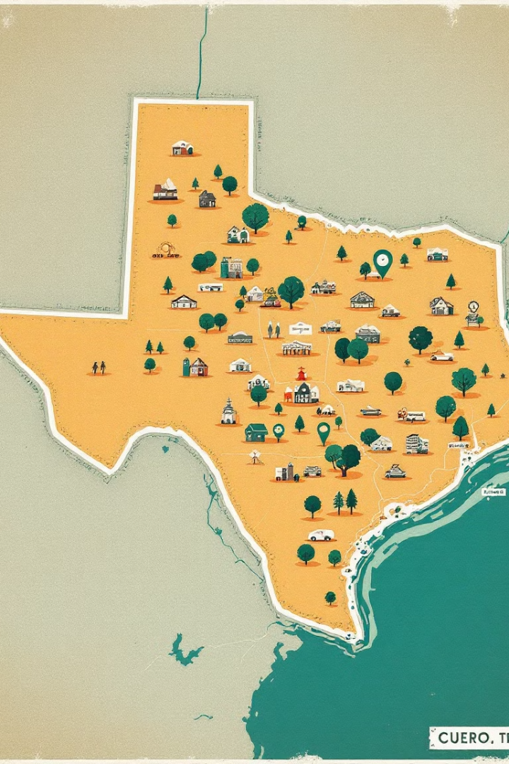
Key Takeaways
1
Economic Growth
2
Regional & Federal Partnerships
Driven by investments in grants, workforce development, and infrastructure.
Amplify Cuero's opportunities
3
Advocacy
For resources in our communities

Slide 9
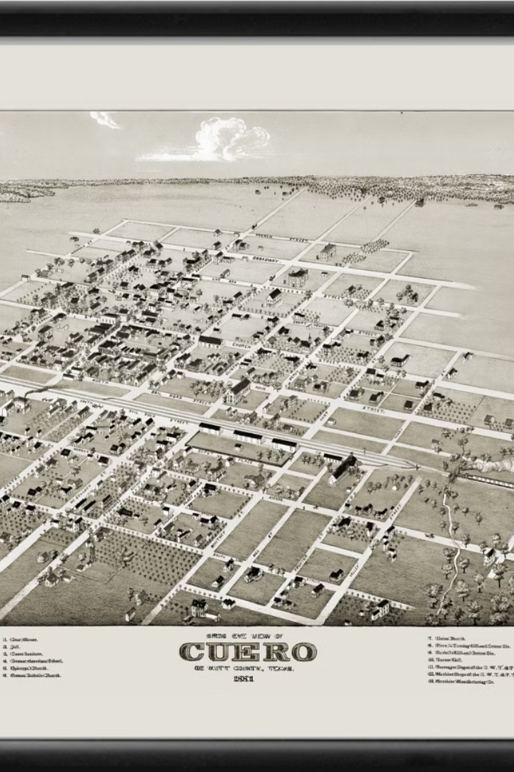



Call to Action
We invite businesses, residents, and investors to be part of Cuero’s success story.
Businesses
Residents
Partner with the CDC for resources and support.
Participate in community initiatives and champion Cuero's development.
Investors
Explore opportunities to contribute to Cuero's growth.

